Slide 1
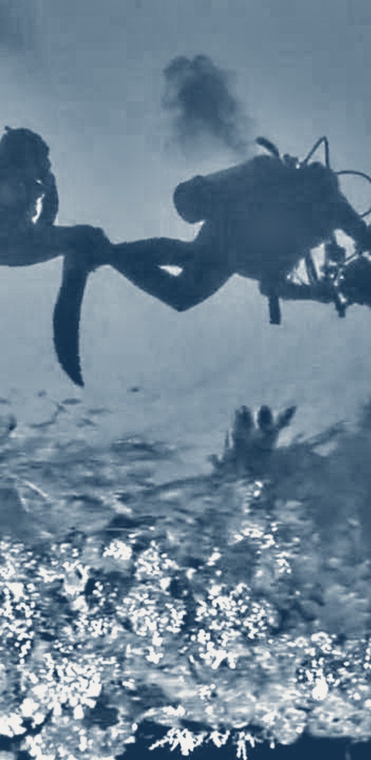
Underwater image enhancement
APPLIED DIGITAL IMAGE PROCESSING
replicating CDEF from scratch
Yuan, Zhang & Cai, “Underwater Scene Enhancement via Adaptive Color Analysis and Multispace Fusion,” IEEE J. Oceanic Eng., 2025
Presentation by
Sarosh Mehdi
CS/CE 446/452
Notes:
Hi, I’m Sarosh. My project replicates CDEF, a 2025 IEEE Journal of Oceanic Engineering method for enhancing underwater images, implemented from scratch in Python. I’ll cover the method and why each part is there, how I implemented it, and my preliminary results on all four datasets the paper uses.

Slide 2
The problem and the paper
APPLIED DIGITAL IMAGE PROCESSING
01 · CDEF (IEEE JOE, 2025)
Classic image processing only, no training
Decides if an image is greenish or bluish and adapts to it
Makes four enhanced versions and fuses them pixel by pixel
Why underwater images look bad
Red light is absorbed first, so scenes turn green or blue
Little light reaches the scene: dark, low contrast
Particles scatter light back: haze and blurred edges
Every image is degraded differently
02 · Why this method
Needs no ground truth, which real underwater scenes never have
Adapts per image instead of one fixed correction
Tackles colour, light, contrast, edges and haze in one pipeline
Every stage is interpretable and can be checked on its own
Paper: best URanker on all 4 datasets vs 15 methods, 6 of them deep
Sarosh Mehdi | CS/CE 446/452
2
Notes:
Underwater, red light is absorbed within a few metres, so images turn green or blue. There is also little light, and suspended particles scatter light back into the camera, which adds haze and blurs edges. CDEF is a training-free method: it first decides whether the image is greenish or bluish, corrects it, then makes four differently enhanced versions and fuses them. I chose it for four reasons. It needs no training data, which matters because real underwater scenes have no true clean reference; even UIEB’s references were picked from enhanced outputs. It adapts to each image through the tone test instead of applying one fixed correction. It handles all the degradations together, since each fused input targets a different one. And every stage is classic, interpretable image processing, so each can be tested and ablated on its own. Finally, it performs well: in the paper’s Table II it has the highest URanker score on all four datasets against fifteen other methods, nine traditional and six deep-learning ones, and in Table I it is in the top three on fifteen of the sixteen metric and dataset pairs. Its runtime is moderate, 0.72 hours for the 890 UIEB images, faster than other fusion and physics-based methods.

Slide 3
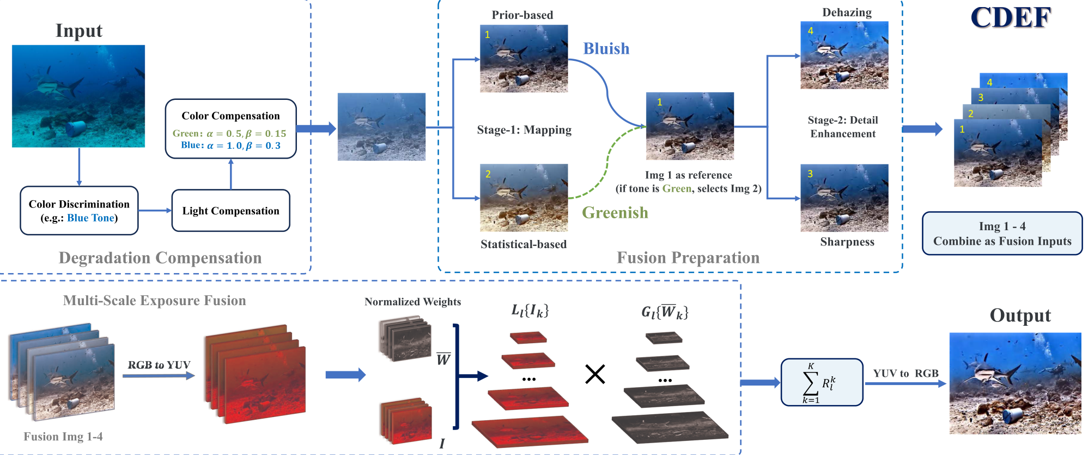
The CDEF pipeline
APPLIED DIGITAL IMAGE PROCESSING
The paper’s own overview of the method:
Top left: degradation compensation
Top middle: the four fusion inputs
Bottom: multi-scale fusion in YUV
Figure: Yuan, Zhang & Cai, IEEE JOE 2025, Fig. 2
Sarosh Mehdi | CS/CE 446/452
3
Notes:
This is the paper’s own overview of the method. Top left is degradation compensation: the colour discrimination decides the tone, then light compensation and colour compensation with the tone’s alpha and beta. Top middle is fusion preparation: two mappings give images 1 and 2, the tone picks which one is the reference, and from it dehazing and sharpening give images 3 and 4. The bottom row is the multi-scale exposure fusion: the four images go to YUV, get normalised weights, and are blended over Laplacian and Gaussian pyramids before converting back to RGB.

Slide 4
Methodology three phases
APPLIED DIGITAL IMAGE PROCESSING
01 · Compensate the degradation
Tone test: mean G vs mean B (Eq. 3)
Luminance compensation (BIMEF)
Colour compensation in Lab (Eqs. 1–2)
02 · Make four inputs
F3 and F4 start from F1 if the image is greenish and from F2 if it is bluish (Algorithm 1).
F1: statistic stretch (Eq. 4)
F2: grey-world stretch (Eqs. 5–6)
F3: CBM contour sharpening
F4: IDE dehazing
03 · Fuse them
Per-pixel weights: contrast, saturation, saliency, exposure (Eqs. 7–11)
Laplacian / Gaussian pyramids in YUV (Eqs. 12–14)
Sarosh Mehdi | CS/CE 446/452
4
Notes:
The method has three phases. Phase one compensates the degradation: a simple test compares the mean green and blue channels to decide the tone, then luminance is fixed with BIMEF and colour is fixed in Lab space. Phase two produces four inputs: two contrast stretches, a sharpened version from Contour Bougie Morphology and a dehazed version from IDE. Phase three fuses them with per-pixel weights over image pyramids in YUV. The tone decides which stretch feeds the detail stages.

Slide 5
Why each step is there
APPLIED DIGITAL IMAGE PROCESSING
Each step targets one degradation, and the ablation (slide 9) tests whether each one earns its place.
Step | Problem it fixes | Why this algorithm
Tone test | Green, blue water differ | Own α, β: greenish 0.5, 0.15; bluish 1.0, 0.3
Luminance (BIMEF) | Dark scenes | Brightens only dark regions; bright image: k = 1
Colour comp. (Lab) | Green / blue cast | Lab splits colour from lightness
F1, F2 stretches | Low contrast | Two stretches, one suited to each tone
F3 CBM | Blurred edges | Morphological top-hats add back contours
F4 IDE | Haze from scattering | Dehazing with an exposure term: no dimming
Pyramid fusion | No input best everywhere | Best input per pixel; pyramids avoid seams
Sarosh Mehdi | CS/CE 446/452
5
Notes:
Each step targets one degradation. The tone test exists because green and blue water attenuate differently, so the paper uses different compensation strengths. BIMEF only brightens under-exposed regions; for a bright image its exposure ratio k is 1 and nothing changes. Colour is corrected in Lab because colour and lightness are separate there, so the cast can be removed without changing brightness. The two stretches handle contrast, CBM restores edges, IDE removes haze without darkening. Fusion is needed because each input is good in different regions, and pyramids blend them without visible seams. The ablation later checks each of these.

Slide 6
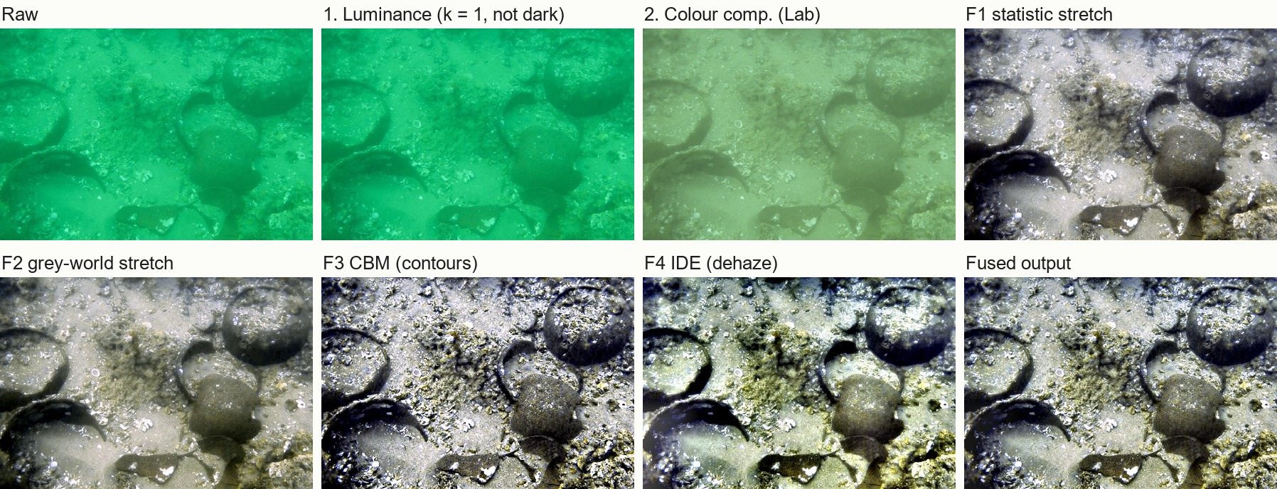
Every stage, one image
APPLIED DIGITAL IMAGE PROCESSING
UIEB 18_img_: classified greenish (α = 0.5, β = 0.15), k = 1, IDE t_min = 0.52. Generated with enhance() from cdef_paper/pipeline.py.
Sarosh Mehdi | CS/CE 446/452
6
Notes:
This is one UIEB image through the pipeline, taken from the debug output of my enhance function. It is classified greenish. It is not dark, so BIMEF picks k equal to 1 and leaves it unchanged. Colour compensation in Lab removes most of the green cast. F1 and F2 restore contrast, CBM sharpens edges, IDE removes haze, and the fused output combines the best parts of each.

Slide 7
Results on four datasets
APPLIED DIGITAL IMAGE PROCESSING
Dataset | UCIQE | FDUM | CEIQ | CCF | URanker
UIEB (890), ours | 0.6502 | 0.8688 | 3.5697 | 44.31 | 2.361
UIEB, paper | 0.6468 | 0.8307 | 3.5544 | 45.11 | 2.399
C60 (60), ours | 0.6331 | 0.6120 | 3.4760 | 36.27 | 1.819
C60, paper | 0.6315 | 0.5832 | 3.4867 | 36.04 | 1.821
EUVP (515), ours | 0.6442 | 0.7385 | 3.6156 | 58.99 | 3.259
EUVP, paper | 0.6367 | 0.7062 | 3.6076 | 57.81 | 3.321
UCCS (300), ours | 0.6158 | 0.6673 | 3.6493 | 44.46 | 2.601
UCCS, paper | 0.6077 | 0.5925 | 3.6328 | 43.74 | 2.575
1,765
images scored across UIEB, C60, EUVP and UCCS
Raw-image scores match the paper’s Table I exactly: same data, same metric code.
No-reference metrics, higher is better.
Within 2% of the paper on UCIQE, CEIQ, CCF and URanker. FDUM is about 5% above it (12.6% on UCCS).
Sarosh Mehdi | CS/CE 446/452
7
Notes:
Before scoring my outputs I scored the raw images: they match the paper’s Table I to every printed digit, which confirms I have the same images and the same metric code. On the enhanced images, UCIQE, CEIQ, CCF and URanker are within 2 percent of the paper on all four datasets. FDUM is the one metric that stays above it: about 5 percent on UIEB, C60 and EUVP and 12.6 percent on UCCS. FDUM rewards fine texture, sharpness and saturated colour, so a slightly sharper output scores higher. URanker improved on 1,762 of the 1,765 images. These metrics reward contrast and colourfulness, so higher does not automatically mean better.

Slide 8
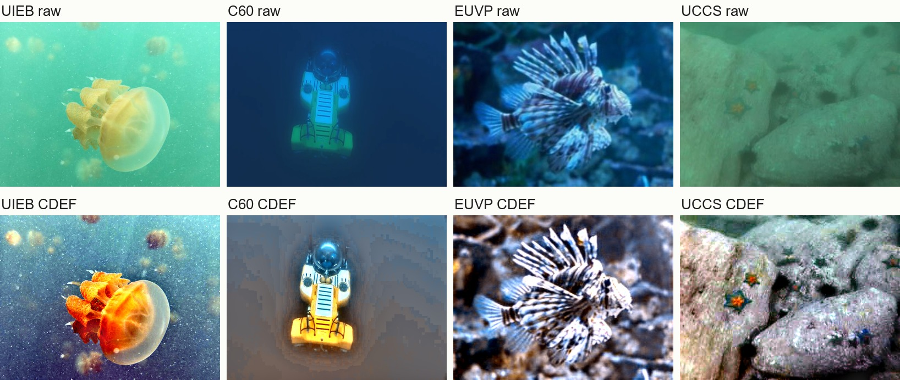
Raw vs our CDEF output
APPLIED DIGITAL IMAGE PROCESSING
One image per dataset. Casts removed and detail recovered. The bottom row is our implementation’s output.
Sarosh Mehdi | CS/CE 446/452
8
Notes:
Here is one image from each dataset. The green and blue casts are gone, and detail comes back in the fish and in the UCCS rocks, where the starfish regain their orange colour. One honest weakness: around the bright ROV in the C60 image there is a dark halo. It comes from the box-smoothed transmission map in IDE.

Slide 9
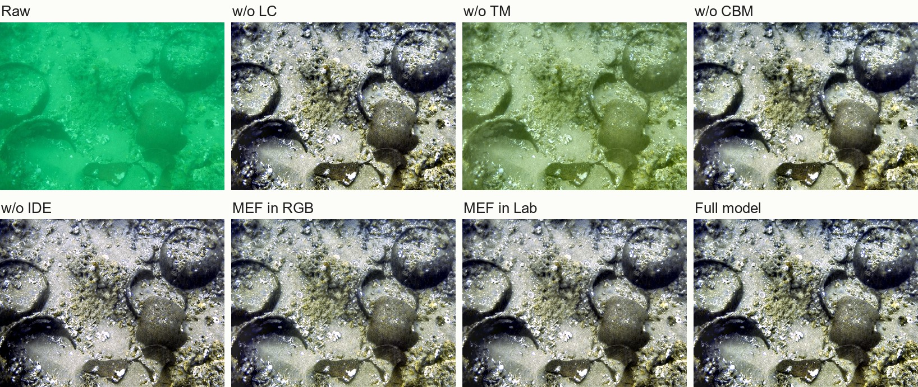
Ablation one greenish image
APPLIED DIGITAL IMAGE PROCESSING
Without tone mapping (w/o TM) a yellow-green cast stays
Without CBM the edges are softer
The other variants stay close to the full model
UIEB 18_img_, our outputs
Sarosh Mehdi | CS/CE 446/452
9
Notes:
This is one greenish UIEB image with each stage turned off in turn. Without tone mapping a strong yellow-green cast is left, which is why that variant drops the most. Without CBM the edges are softer. The other variants are visually close to the full model, which matches their small score changes.

Slide 10
Open problems and next steps
APPLIED DIGITAL IMAGE PROCESSING
Open problems
Next steps
Binary green/blue switch with two fixed α, β pairs; blue-green scenes sit between them
Same compensation for every image, so decent images get over-enhanced
Some stages are off-the-shelf (e.g. IDE), not built for underwater
Slow on large images: 1.2 s at 800×450, 11 s at 2180×1447 (BIMEF)
Ext. 1 (fixes 1): continuous α, β from the strength of the cast (G/B ratio or Lab hue); test on UCCS blue, green and blue-green
Ext. 2 (fixes 2): scale compensation by how degraded the image is (BIMEF’s k or mean brightness); test on C60
Ext. 3 (fixes 3): swap stages, e.g. an underwater dehazer for IDE, a saturation weight suited to YUV; measure each swap alone
Sarosh Mehdi | CS/CE 446/452
10
Notes:
To wrap up, four open problems. Three are limitations of the method itself. First, the tone test is a binary switch between two fixed parameter pairs, so blue-green scenes fall between the classes. Second, every image gets the same compensation strength, so images that are already decent can be over-enhanced. Third, some stages are off-the-shelf methods, like IDE, that were not designed for underwater images. The fourth is speed: it is slow on large images because of BIMEF. My three extensions target the first three. Extension one computes alpha and beta continuously from the strength of the cast, using the green-to-blue ratio or the hue angle in Lab, and UCCS already has blue, green and blue-green folders of 100 images each to test whether two classes are enough. Extension two scales the compensation by how degraded the image is, using BIMEF’s exposure ratio k or mean brightness, tested on the challenging C60 set. Extension three replaces off-the-shelf stages, for example an underwater-specific dehazer instead of IDE and a saturation weight that works properly in YUV, measuring each swap on its own.

Slide 11
Thank you
Questions?
Sarosh Mehdi | CS/CE 446/452
Notes:
Thank you, I’m happy to take questions.

